Slide 1

Netflix Stock Insights: An Integrated Analytics Approach
Group 4 – DAMO-611-6

Slide 2


Problem Definition & Objectives
Markets are volatile and uncertain → forecasting is difficult.
Objective: Can models forecast next-day Netflix prices better than a naive baseline?
Secondary Objective: What do volatility and volume tell us about risk?

Slide 3
Research Questions
Volatility & Events: How did Netflix’s stock volatility differ during stable market years (2018–2019) compared with the COVID-19 pandemic period (2020–2021), when uncertainty and consumer behavior shifted dramatically?
Volume–Price Dynamics: To what extent does unusually high trading volume (top 25% of daily observations) explain large price fluctuations (≥ ±3%) in Netflix’s stock?
Predictive Modeling Accuracy: Can regression or ARIMA time-series models forecast short-term Netflix stock prices more accurately (measured using RMSE) than a simple naïve random walk benchmark?

Slide 4
Hypothesis
H1: Volatility during 2020–2021 was significantly higher than in 2018–2019.
H2: High-volume trading days (top quartile) are associated with a higher probability of ≥ ±3% price moves.
H3: Ridge regression with engineered features achieves ≥15% RMSE improvement over the Naive baseline; ARIMA is expected to perform similarly to Naive.

Slide 5
Data & Methods
Dataset: Netflix OHLCV (2002–2025, ~4,874 records).
Feature Engineering: Lag1, returns, log returns, SMA(5), SMA(20), rolling volatility, RSI(14).
Models Implemented:
Naive Baseline → carry-forward price (benchmark).
Linear Regression (Lag1 only)
Ridge Regression
ARIMA (1,0,0)
Tools: Python (EDA, modeling), Tableau (visual dashboards).
Presentation
/ 04

Slide 6
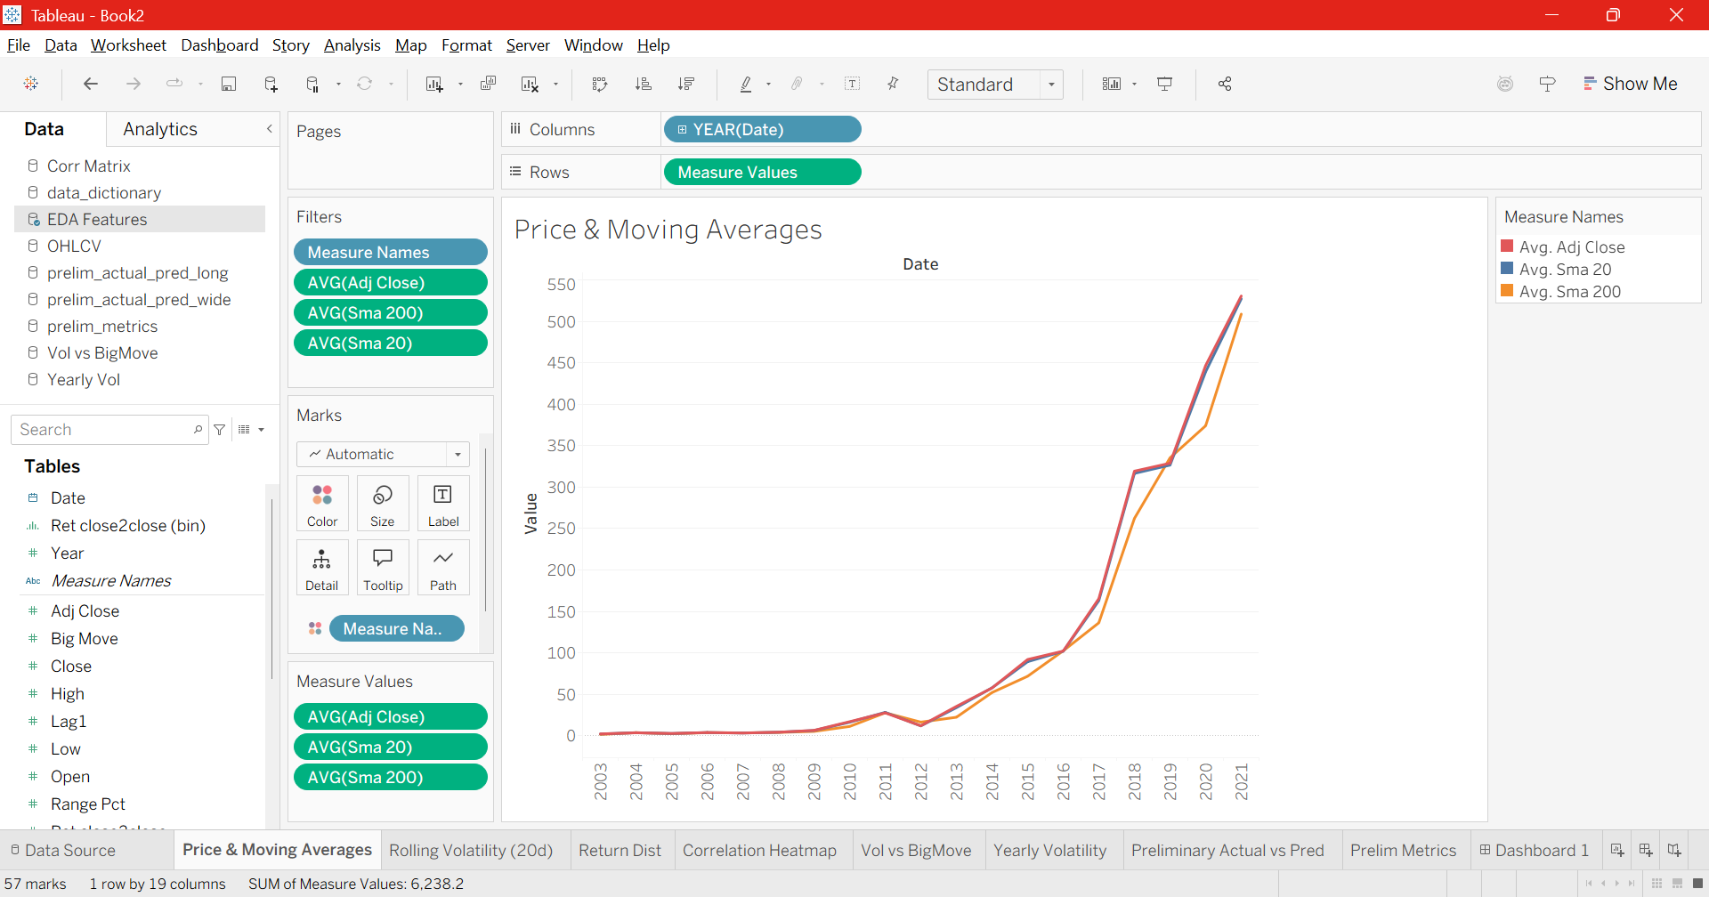
Visualization: Price & Moving Averages
“SMA20 reacts faster to short-term changes, while SMA200 highlights long-term trend regimes.”

Slide 7
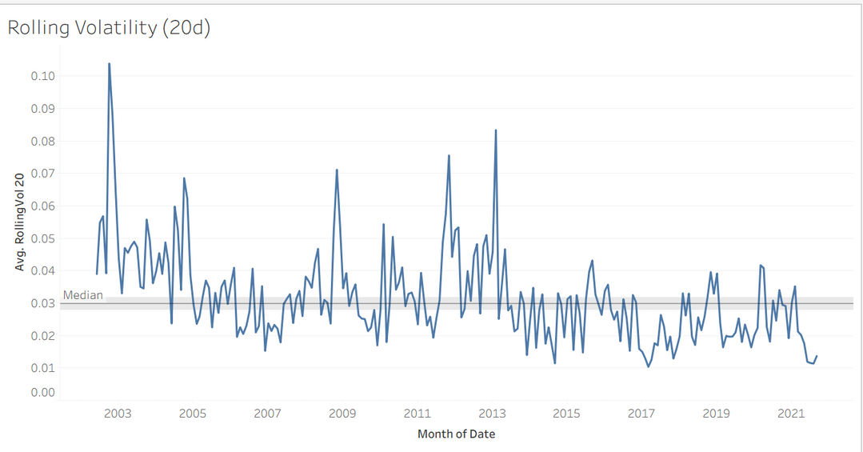
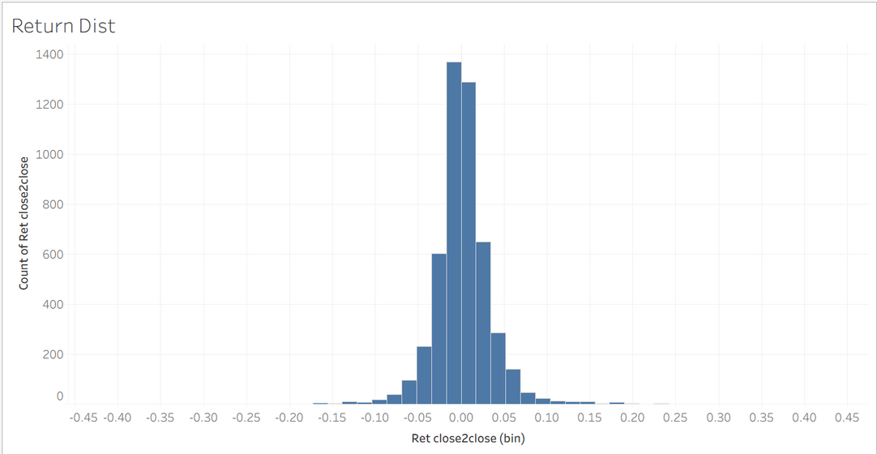
Visualization: Volatility & Returns
“Volatility spikes in crisis years, and return distribution shows fat tails with extreme events.”

Slide 8
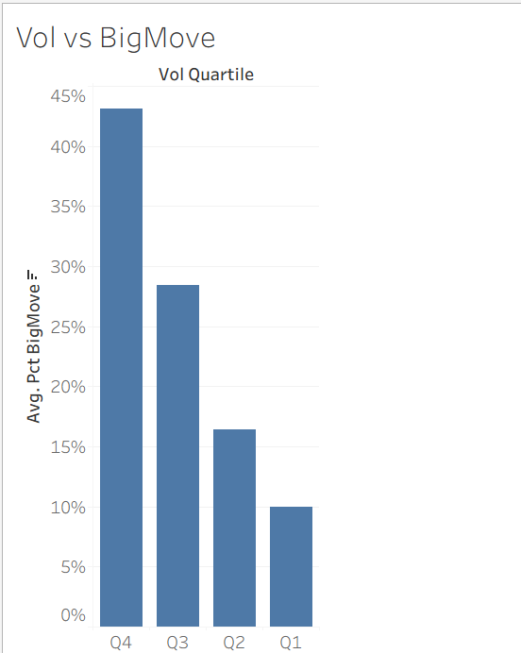
Visualization: Volume vs Big Moves
“High-volume days are strongly associated with a greater chance of large price swings.”

Slide 9
Modeling Approach
Naive Baseline → Yesterday = Today (benchmark).
Linear Regression (Lag1) → Captures simple autocorrelation.
Ridge Regression → Uses engineered features; avoids overfitting.
ARIMA (1,0,0) → Classical time-series tuned by AIC.
Validation → Expanding window cross-validation (to avoid leakage).

Slide 10
Results: Model Metrics
Naive Baseline: RMSE ≈ 15.2, R² ≈ 0.74
Linear Regression (Lag1): RMSE ≈ 15.17, only minor improvement
Ridge Regression: RMSE ≈ 11.5, ~24.5% improvement over Naive, R² ≈ 0.86
ARIMA (1,0,0): RMSE ≈ 15.18, almost identical to Naive
Key Takeaway:
Ridge significantly outperformed the other models, while ARIMA failed to beat the Naive baseline.

Slide 11
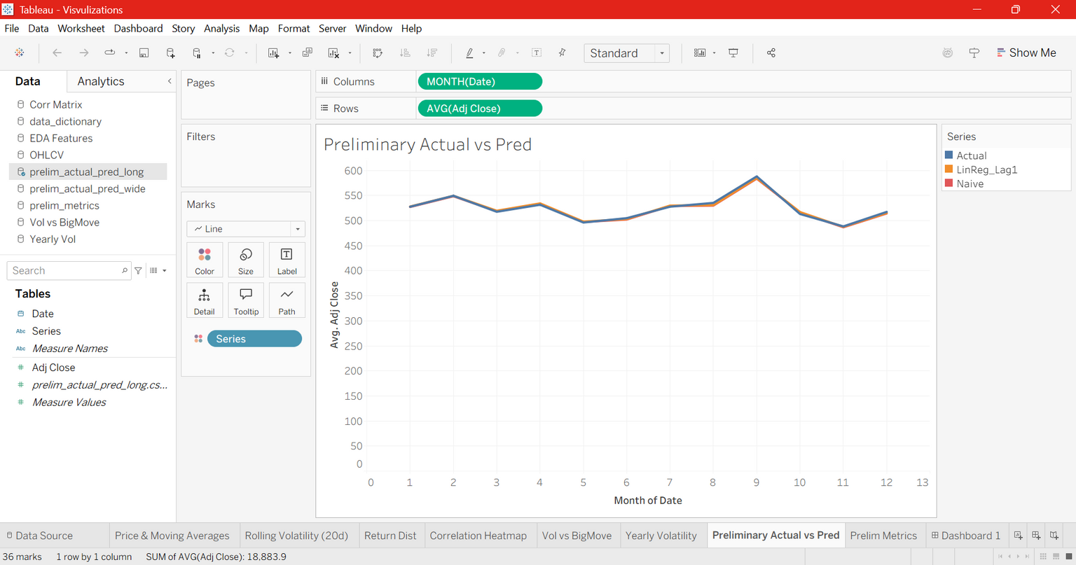
Results & Interpretation
Ridge tracks actual prices better; ARIMA adds little value.

Slide 12
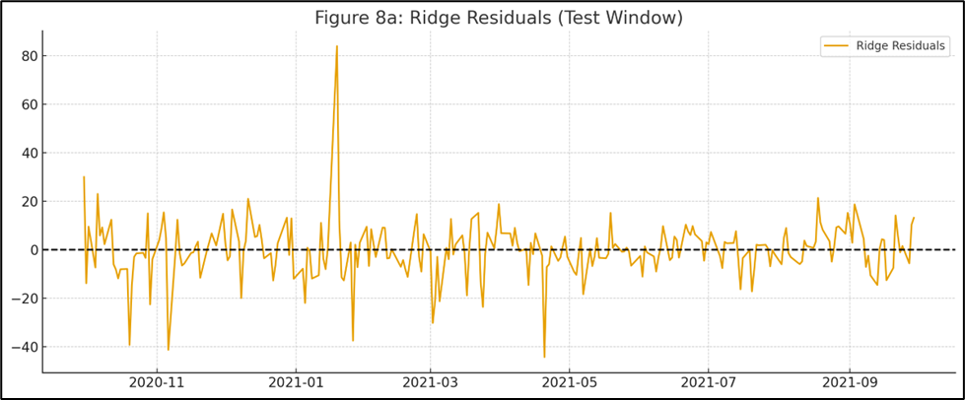
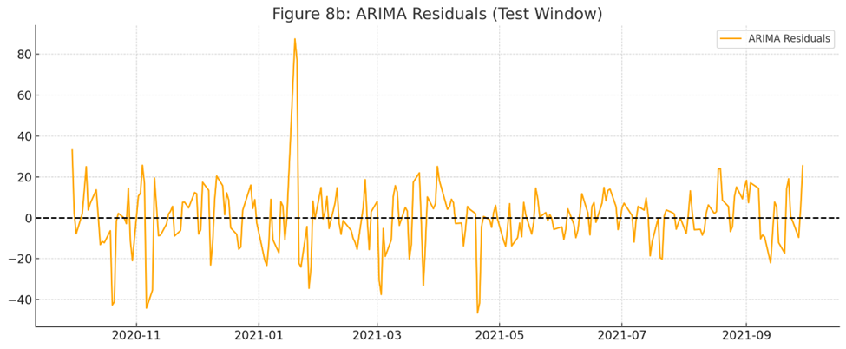
Residual Diagnostics
“Ridge residuals resemble white noise, while ARIMA residuals show unexplained structure.

Slide 13
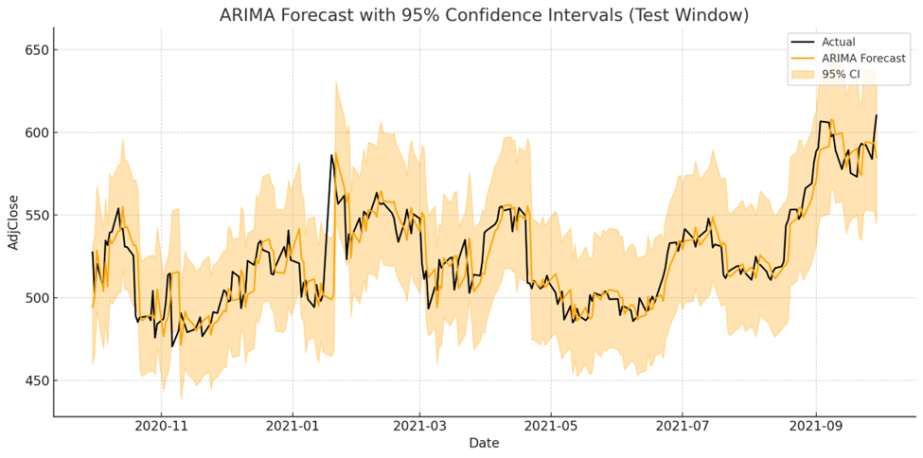
ARIMA Forecast Intervals
“Forecast intervals widen during volatile periods, highlighting higher uncertainty.”

Slide 14

Business Impact
Ridge = modest but measurable forecasting edge.
Volume + volatility insights = risk monitoring.
ARIMA intervals = uncertainty awareness.
“So what does this mean for decision makers?
For traders, Ridge provides a modest edge in predicting short-term prices.
For risk managers, monitoring trading volume and volatility can serve as early warnings for turbulence.
And for executives, ARIMA’s intervals highlight the need to account for uncertainty, especially in crises.”

Slide 15
Limitations & Recommendations
Our project has limitations. We only used Netflix’s own stock data, without incorporating external signals like market indices, news, or macroeconomic variables. Ridge is linear, so nonlinear relationships may be missed.
For future work, we recommend testing nonlinear machine learning models like Random Forest, XGBoost, or LSTMs. Adding exogenous features like earnings announcements or sentiment could further improve forecasts. Rolling multi-window validation should also be applied for robustness.”

Slide 16

Conclusion
H1: Supported (volatility higher during crises).
H2: Supported (high volume = more big moves).
H3: Partially supported (Ridge improved; ARIMA did not).
Our analysis strongly supports Hypothesis 1 and Hypothesis 2.
Volatility was higher in crises, and high volume days correlated with big moves.
Hypothesis 3 was partially supported — Ridge regression clearly improved forecast accuracy, while ARIMA did not outperform Naive.
Together, these results show both the potential and the limits of stock price forecasting
Presentation

Slide 17


